Slide 1




Spinal Immobilisation Study
SIS Background
(Paramedic Team)

Slide 2
The research team:
Warwick University:
Gavin Perkins – Chief Investigator
Christina Ryan– Trial Manager
Susan Arthur – Trial Co-Ordinator
Dalbir Kaur– Senior Project Manager
Imperial College London:
Mark Wilson – Chief Investigator
Lyn Morgan – Trial Manager
Sarah Fryer – Research Nurse
Emily Ashworth – Research Nurse
Contact email:
SIS@warwick.ac.uk
Sis1.imperial@nhs.net

Slide 3
Background
Traumatic spinal cord injuries occur worldwide
Injuries can be both life threatening and life changing
The mechanism can vary from road traffic collisions to falls
Globally, incidence rates vary from 8 to 246 cases per million population

Slide 4
Background
The benefits of effective spinal immobilisation are:
  It reduces the risk of secondary injury and can facilitate extrication/transport
The risks are:
Aspiration pneumonia, pressure sores, increased intracranial pressure and head and neck pain.
Spinal immobilisation is the standard of practice for suspected spinal cord injury
Current spinal immobilisation practices vary

Slide 5

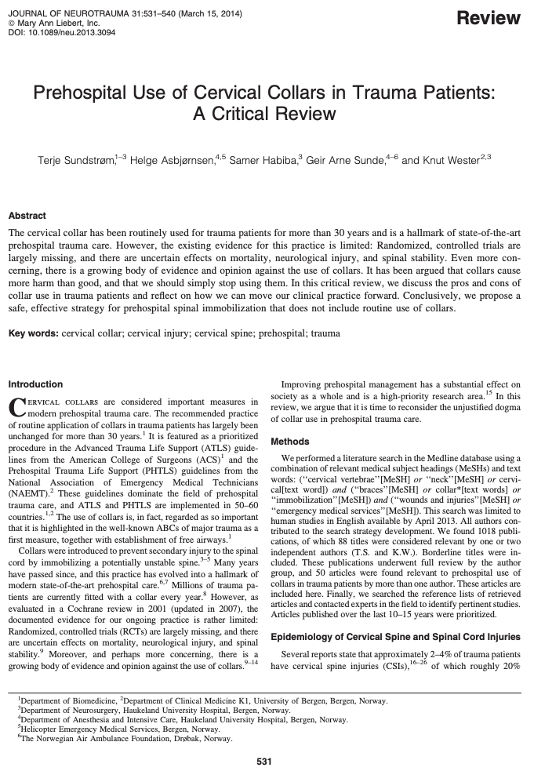
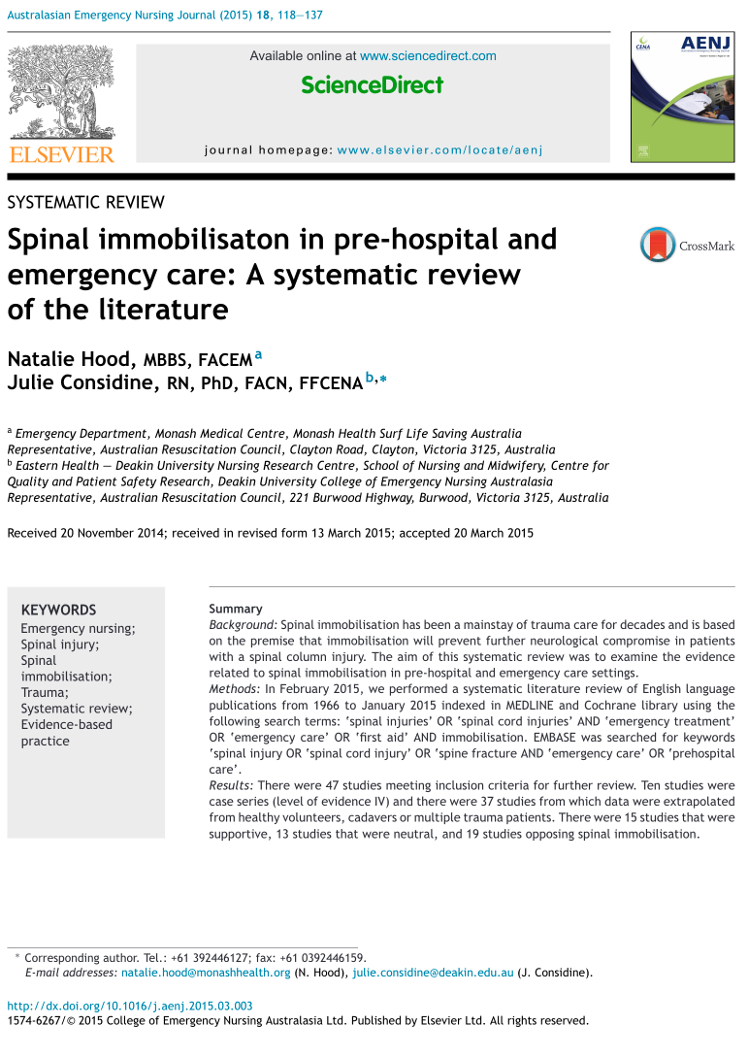
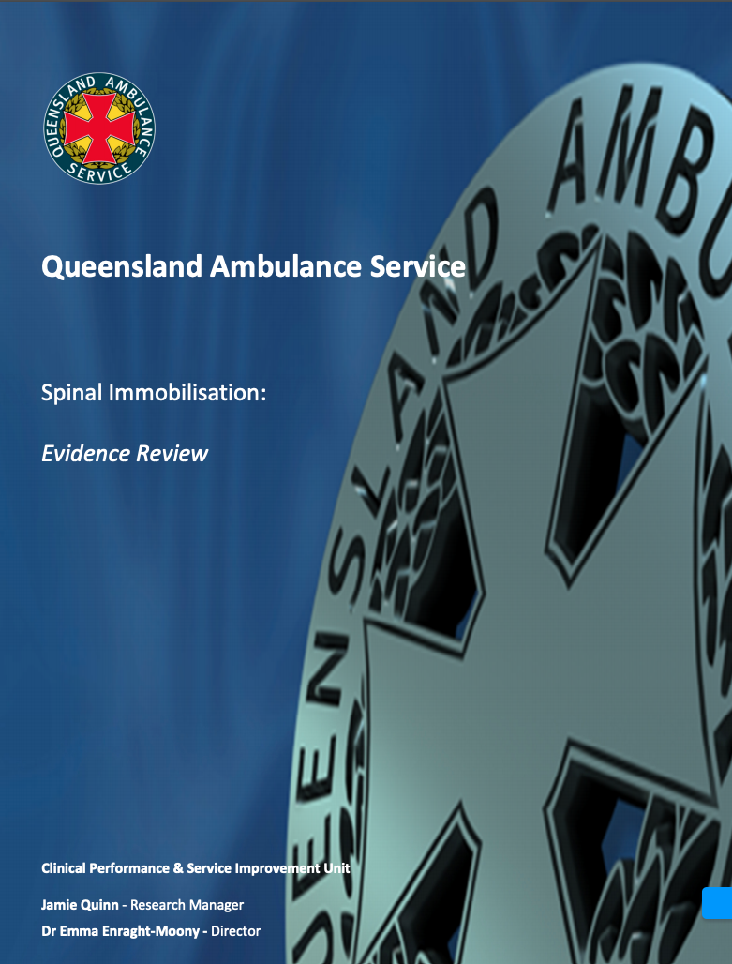
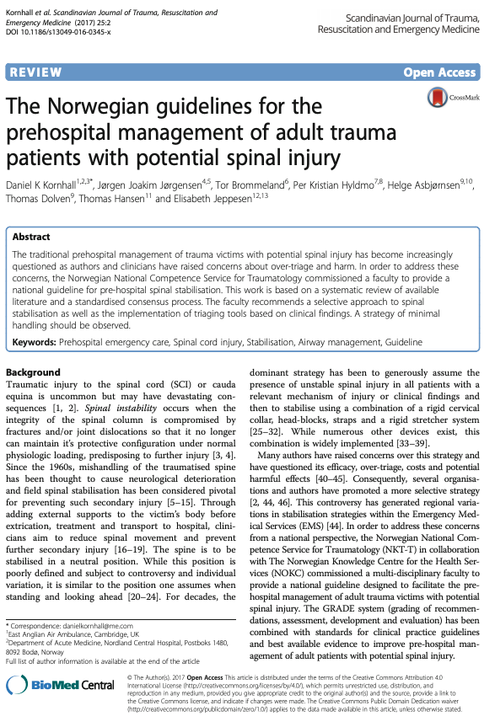
Previous Research

Slide 6
Clinical Need for Research
Triple Immobilisation perceived to cause harm (aspiration pneumonia, pressure sores, raised ICP, discomfort)​
However, failure to protect c-spine resulting in neurological deterioration is devastating for patient and has significant medico-legal cost​
Considerable difference in clinician opinion demonstrated​
Considerable patient interest (immobilisation complications are temporary, spinal injury is permanent)

Slide 7
Aim
To determine whether movement minimisation is deemed non-inferior compared to triple immobilisation in relation to functional outcome at hospital discharge

Slide 8
Design
Ambulance service
Trauma Centre/Unit
Imperial Research Staff
On scene
Randomised through a Web App
In hospital
Participant or consultee approached for consent
After discharge
Follow up completed at Day 30 and 180
Allocated to triple immobilisation or movement minimisation
Initials, age range and hospital number entered onto app
FIM and secondary outcome measures collected after consent and at hospital discharge
Includes FIM, hospital admission and health resource use
Baseline data
4158 patients randomised to each arm

Slide 9
Timeline
Pilot study starts
(6 months) ~ 800 patients
Main Study starts
(2 years) ~ 8000 patients
Follow-up for 6 months
The study will last for 3 years in total from first recruitment to last follow-up
Approx end date May 2026

Slide 10
Inclusion/Exclusion
Inclusion Criteria:​
Out of hospital with treatment being provided by NHS Ambulance Service staff
Patient assessed & found to require spinal immobilisation according to NHS Ambulance guidelines
Any GCS​
Transfer planned to ED​
​Exclusion Criteria:​
Patients not requiring spinal immobilisation according to NHS Ambulance guidelines
Patients in whom placing a collar is contraindicated (e.g. pre-exisiting spinal deformity)

Slide 11
Paramedic Randomisation
Before recruiting, the randomising paramedic must:
  have completed trial-specific training
  have access to the trial online randomisation system
  have equipment to apply triple immobilisation or movement minimisation

Slide 12
Deferred consent and assent
The majority of patients will not have capacity or the situation will not support informed consent, in which case, deferred consent has been agreed.
If the patient is conscious and has capacity, inform them that the ambulance service is currently comparing two spinal immobilisation techniques and these are being randomly allocated. If the patient objects then do not randomise
(but please record this objection).
Formal consent is done when in hospital.

Slide 13
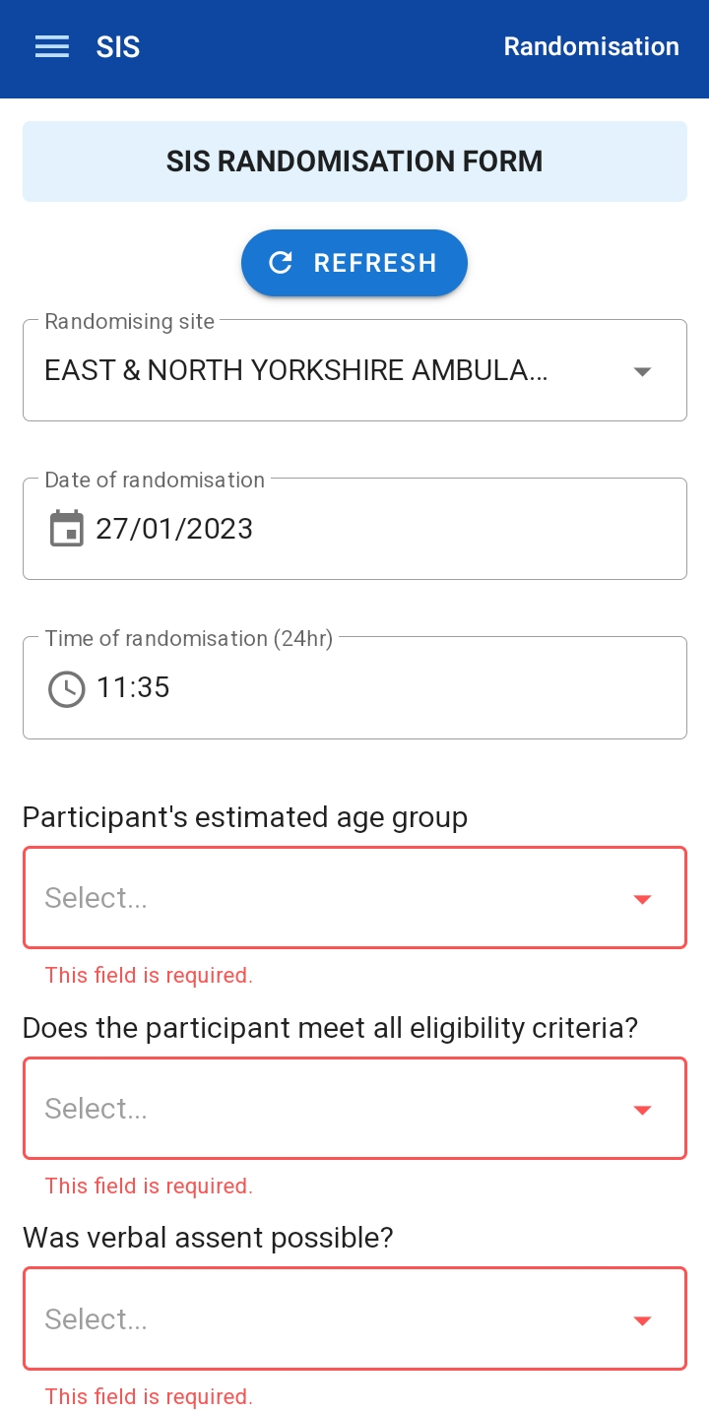
Randomisation
1. Open online randomisation system
- Date, Time and Ambulance Service will auto-populate
2. Confirm patients estimated age
< or > 16 (required for randomisation)
3. Confirm eligibility requirements met
- Note if verbal assent was possible
4. Randomise

Slide 14
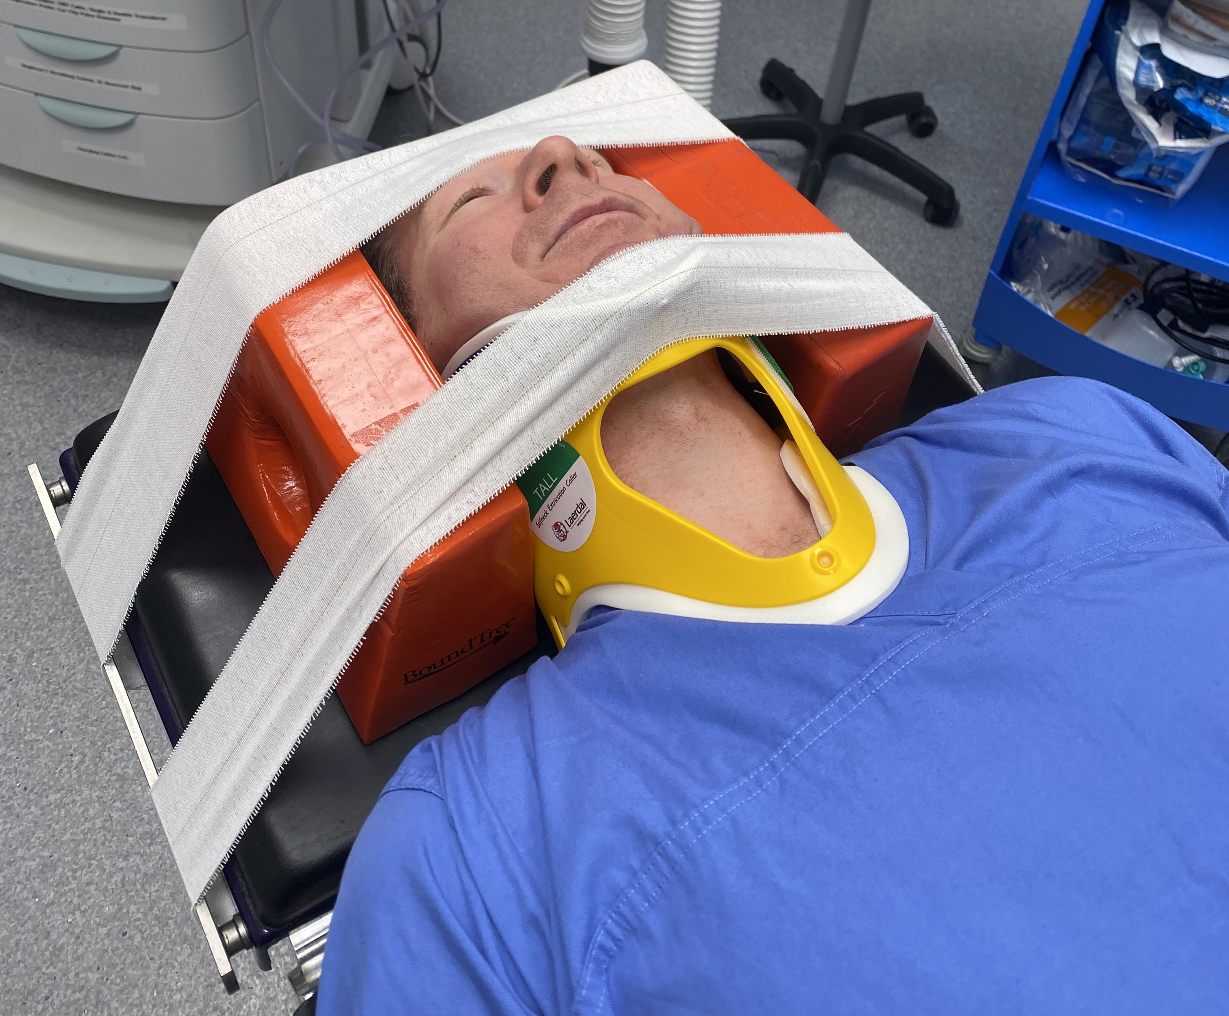
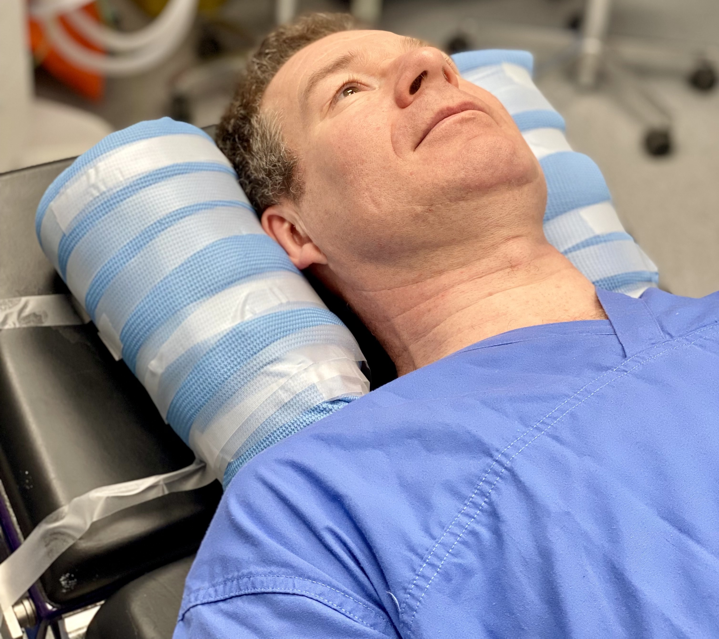
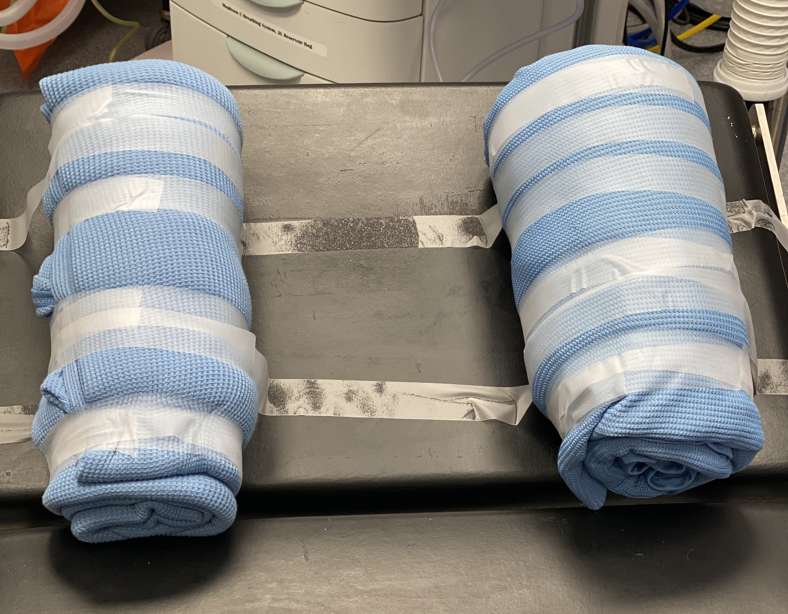
Treatment Arms
Triple immobilisation | Movement minimisation
Cervical Collar Blocks Tape | 2 x rolled blankets Can sit up to 30 degrees

Slide 15
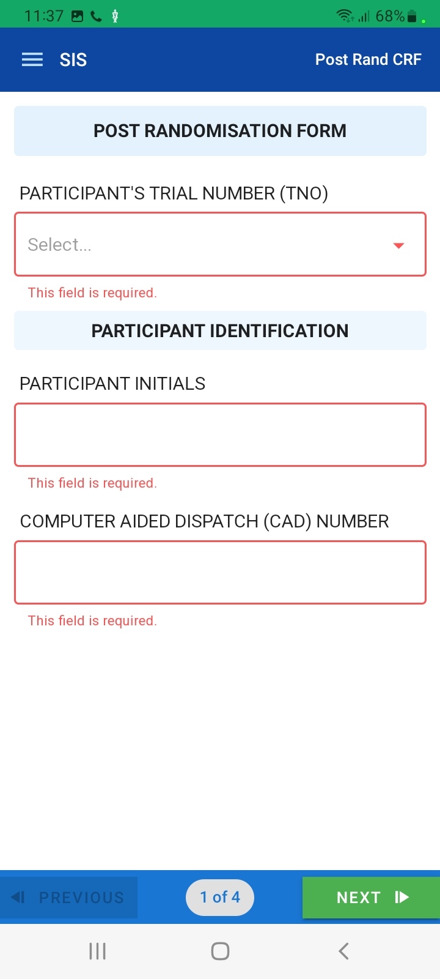
Post Randomisation Documentation
En route or In Hospital, please document:
- Patient Initials, CAD Number
- Date and Time of Injury
- Limb Motor Impairment
- Limb Sensory Impairment
- GCS
- Reported Neck Pain (0 to 10)
- Analgesia given.
- Date and Time of Receiving Hospital
- MRN / Local Hospital Number / NHS

Slide 16
Outcome Measures
Primary:
Functional Independence Measure (Motor) score
Secondary:
Need for pre-hospital analgesia.
Neurological change (randomisation to hospital discharge)
Mortality (30, 90 and 180 days)
Length of stay in critical care and hospital
Further intervention for c-spine injury costs and resource utilisation
Adverse events
Quality of Life:
Quality of life measurements (EQ-5D-5L)

Slide 17
Neurological Assessment
Simplified MRC Power Grading
(Medical Research Council muscle strength grading tool)
For each limb, if the patient is cooperative, please document whether there is any movement.
Assess sensation
(touch, pain, temperature, proprioception, and pressure)
0 = Not present
1 = Altered
2 = Normal
NT = Not Testable

Slide 18
Other data collection
SAEs
Please ensure that any Serious Adverse Events are reported to the trial team as soon as possible (ideally within 24 hours of becoming aware of the event).
SAE forms can be found in the Investigator Site File, and should be emailed to WCTUQA@warwick.ac.uk and SIS@warwick.ac.uk
Non-Compliances
Protocol deviations or violations will be recorded in the case report form on the database and these will also be captured in the WCTU non-compliance log (including actions taken to prevent recurrence)
Any non-compliances that do not fall under the remit of a protocol deviation will also be captured on the WCTU non-compliance log and will be followed up with ambulance services till completion of the CAPA
Serious breaches of the trial protocol or GCP should be immediately reported to SIS@warwick.ac.uk for review and escalation. The Chief Investigator in consultation with the PI will take whatever immediate action is required to safeguard the wellbeing of participant(s)

Slide 19
Other data collection continued…
Training Records
Please ensure that training records are kept for all randomising clinicians. These will be checked against participant randomisations.
Screening Logs
Screening logs will be requested by the trial team on a monthly basis, and can be found in the Investigator Site File

Slide 20
Summary
This is a randomised controlled trial of the clinical and cost-effectiveness of cervical spine immobilisation following blunt trauma running over three years in total.
Acknowledgments
Thank you to the TMG, DMC, Warwick University, Imperial College London, and all the supporting Ambulance Services and Hospitals taking part.

